Slide 1
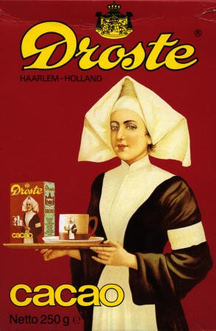
Recursion

Slide 2
What does this method do?
def printStars(self,n):
if n == 1:
print “*",
else:
print “#”,
self.printStars(n-1)

Slide 3
Recursion
recursion: The definition of an operation in terms of itself.
Solving a problem using recursion depends on solving smaller occurrences of the same problem.
recursive programming: Writing methods that call themselves
directly or indirectly
An equally powerful substitute for iteration (loops)
But sometimes much more suitable for the problem

Slide 4
Definition of recursion
recursion: n.
See recursion.

Slide 5
Recursive Acronyms
Dilbert: Wally, would you like to be on my TTP project?
Wally: What does "TTP" stand for?
Dilbert: It's short for The TTP Project. I named it myself.
— Dilbert, May 18, 1994
GNU — GNU's Not Unix
KDE — KDE Desktop Environment
PHP - PHP: Hypertext Preprocessor
PNG — PNG's Not GIF (officially "Portable Network Graphics")
RPM — RPM Package Manager (originally "Red Hat Package Manager")
http://search.dilbert.com/comic/Ttp

Slide 6
Why learn recursion?
A different way of thinking about problems
Can solve some problems better than iteration
Leads to elegant, simple, concise code (when used well)
Some programming languages ("functional" languages such as Scheme, ML, and Haskell) use recursion exclusively (no loops)

Slide 7
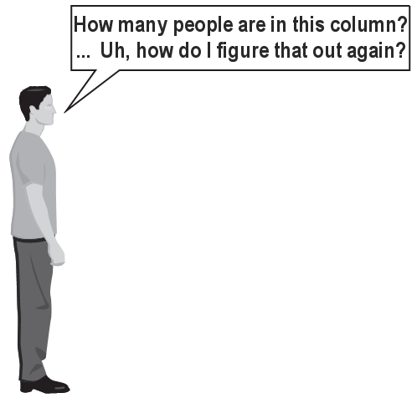
Exercise
(To a student in the front row) How many students are directly behind you?
We all have poor vision, and can only see the people right next to us. So you can't just look back and count.
But you are allowed to ask questions of the person behind you.
How can we solve this problem? (recursively )

Slide 8
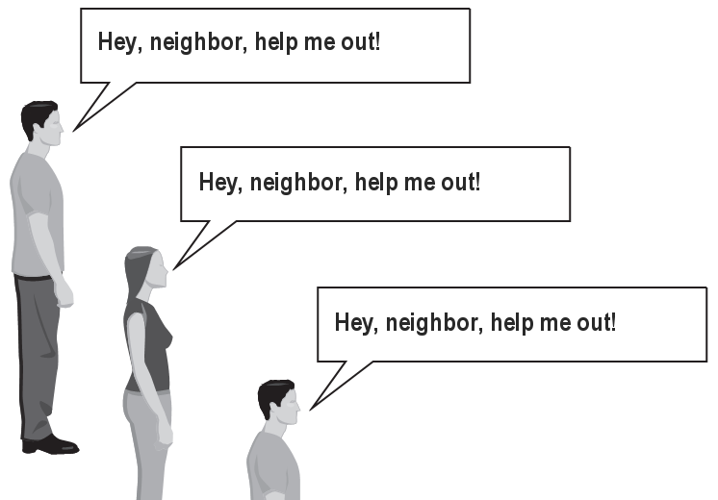
The idea
Recursion is all about breaking a big problem into smaller occurrences of that same problem.
Each person can solve a small part of the problem.
What is a small version of the problem that would be easy to answer?
What information from
a neighbor might help
you?

Slide 9
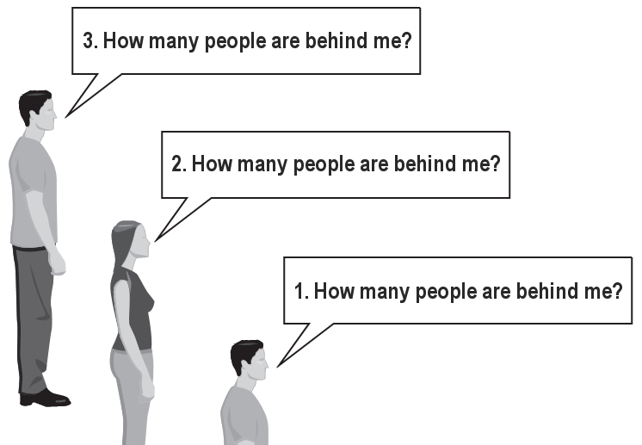
Recursive algorithm
Number of people behind me:
If there is someone behind me, ask him/her how many people are behind him/her.
When they respond with a value N, then I will answer N + 1.
If there is nobody behind me, I will answer 0.

Slide 10
Recursive structures
A directory has
files
and
(sub) directories
An expression has
operators
operands, which are
variables
constants
(sub) expressions

Slide 11
Expressions represented by trees
A tree is
a node
with
zero or more sub trees
examples:
a*b + c*d
(a+b)*(c+d)
+
*
*
a
b
c
d
*
+
+
a
b
c
d

Slide 12
Structure of recursion
Each of these examples has
recursive parts (directory, expression, tree)
non recursive parts (file, variables, nodes)
Would we always need non recursive parts?
Same goes for recursive algorithms.

Slide 13
Cases
Every recursive algorithm has at least 2 cases:
base case: A simple instance that can be answered directly.
recursive case: A more complex instance of the problem that cannot be directly answered, but can instead be described in terms of smaller instances.
Can have more than one base or recursive case, but all have at least one of each.
A crucial part of recursive programming is identifying these cases.

Slide 14
Base and Recursive Cases: Example
def printStars(self,n):
if n == 1:
print "*",
else:
self.printStars(n-1)
print “#",

Slide 15
Recursion Zen
An even simpler, base case is n=0:
def printStars(self,n):
if n == 0:
return
else:
self.printStars(n-1)
print "*",
Recursion Zen: The art of identifying the best set of cases for a recursive algorithm and expressing them elegantly.

Slide 16
Everything recursive can be done non-recursively
def printStars(self,n):
for i in range(n):
print "*",

Slide 17
Recursive power example
Write a method that computes x^{n}. x^{n} = x * x * x * ... * x (n times)
An iterative solution:
def pow(x, n):
product = 1;
for i in range(n):
product = product * x
return product

Slide 18
Exercise solution
// Returns base ^ exponent.
// Precondition: exponent >= 0
def pow(x, n):
if n == 0:
// base case; any number to 0th power is 1
return 1
else:
// recursive case: x^n = x * x^(n-1)
return x * pow(x, n-1)

Slide 19
How recursion works
Each call sets up a new instance of all the parameters and the local variables
When the method completes, control returns to the method that invoked it (which might be another invocation of the same method)
pow(4, 3) = 4 * pow(4, 2)
= 4 * 4 * pow(4, 1)
= 4 * 4 * 4 * pow(4, 0)
= 4 * 4 * 4 * 1
= 64

Slide 20
Infinite recursion
A method with a missing or badly written base case can causes infinite recursion
public int pow(int x, int y) {
return x * pow(x, y - 1); // Oops! No base case
}
pow(4, 3) = 4 * pow(4, 2)
= 4 * 4 * pow(4, 1)
= 4 * 4 * 4 * pow(4, 0)
= 4 * 4 * 4 * 4 * pow(4, -1)
= 4 * 4 * 4 * 4 * 4 * pow(4, -2)
= ... crashes: Stack Overflow Error!

